Slide 1

MACHINE LEARNING

Slide 2
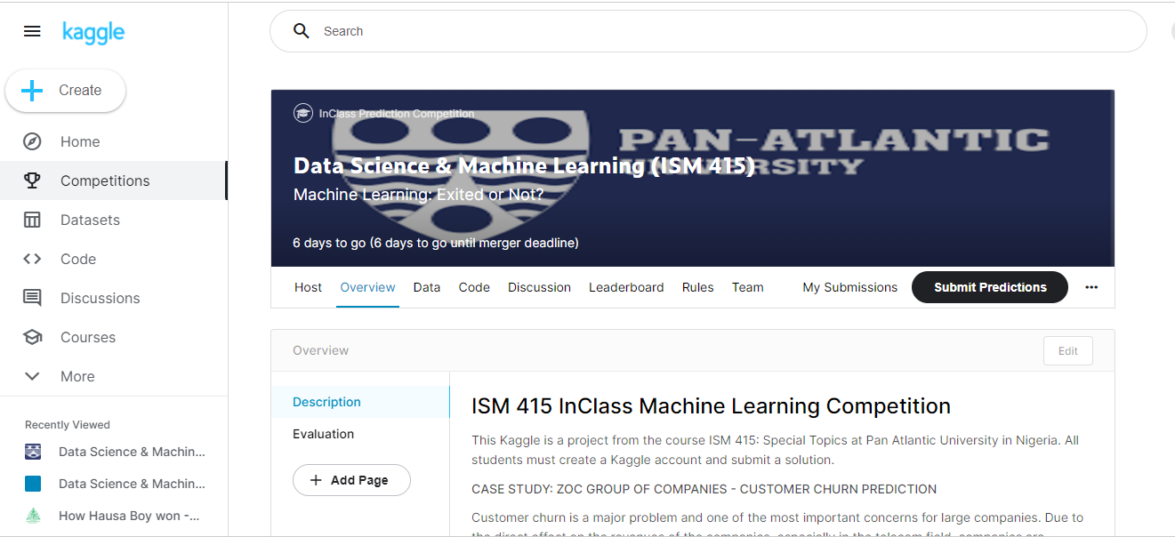

Slide 3

Recap
Introduction to Machine Learning
Understand the concept of machine learning
Important concepts
Machine learning workflow
Practice Lab
Assignment

Slide 4

Objective
More on Supervised Learning
Classification
More on Evaluation
Improving Performance
Case Study
Practice Lab

Slide 5
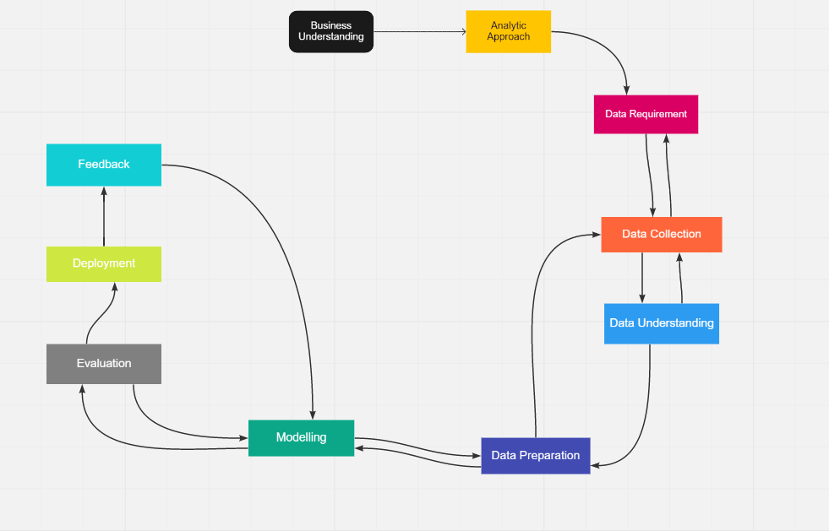

Slide 6
What is supervised learning
Machine learning
Supervised learning
Unsupervised learning
Classification
Regression

Slide 7

Classification
Classification is a type of supervised learning which specifies the class to which element belongs to and tries to predict the output variable.

Slide 8
Use Case
Spam Email Detection
Identify Customer Segment
Loan Approval
Employees or Customers Churn
Identify if a kid will pass or fail an examination.

Slide 9
Applicant ID | GPA | Test results | Accepted
0 | 3.5 | 2.4 | False
1 | 4 | 2.2 | False
2 | 4.2 | 4.3 | True
3 | 4.8 | 2.9 | False
… | … | … | …

Slide 10
Applicant ID | GPA | Test results | Accepted
0 | 3.5 | 2.4 | False
1 | 4 | 2.2 | False
2 | 4.2 | 4.3 | True
3 | 4.8 | 2.9 | False
… | … | … | …

Slide 11
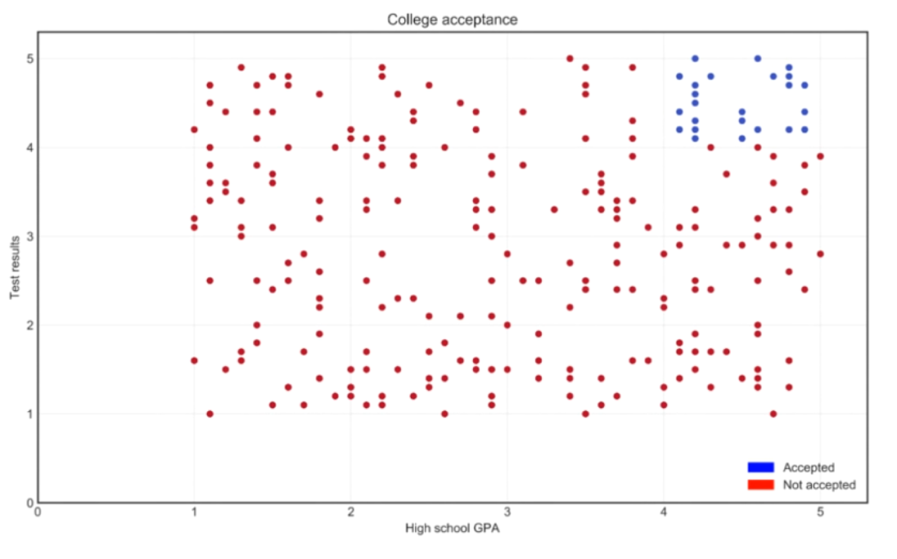

Slide 12
Types of Classification Models
Linear Model
Logistic regression
Support vector machine
Non-Linear Model
K-nearest neighbor
Random forest
Decision tree

Slide 13
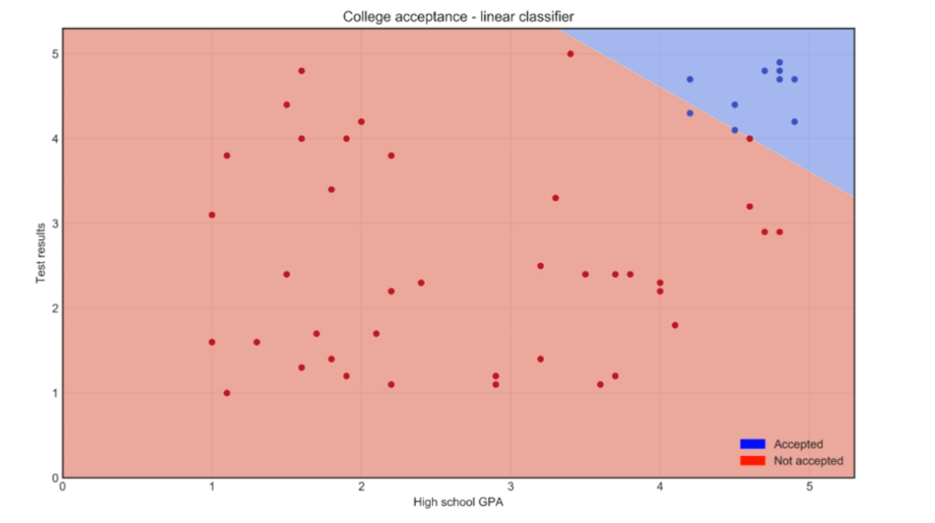

Slide 14
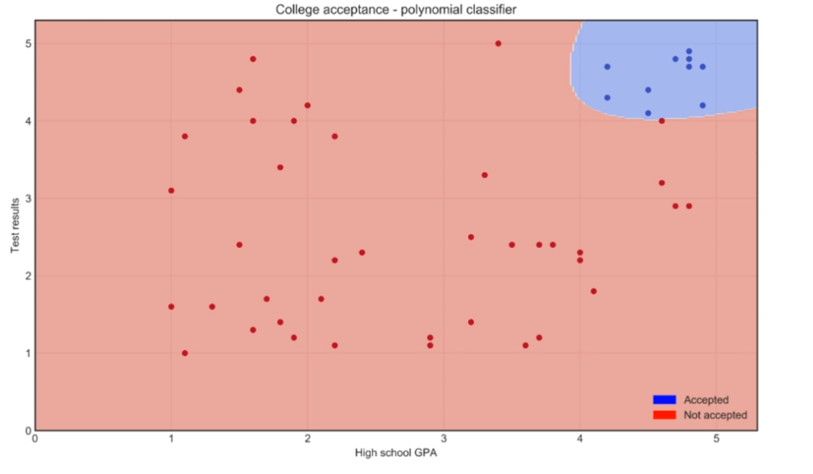

Slide 15
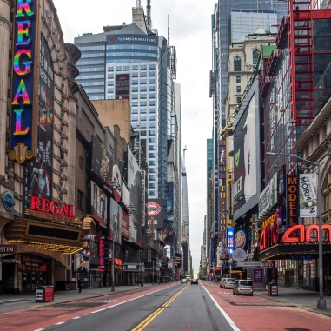
Evaluate step
Raw data
Test dataset
1. Extract features
2. Split dataset
Train data
3. Train model
4. Evaluate

Slide 16
Overfitting
Performs great on training data
Performs poorly on the testing data
Model memorized training data and can’t generalize learning to new data
Use testing set to check model performance

Slide 17
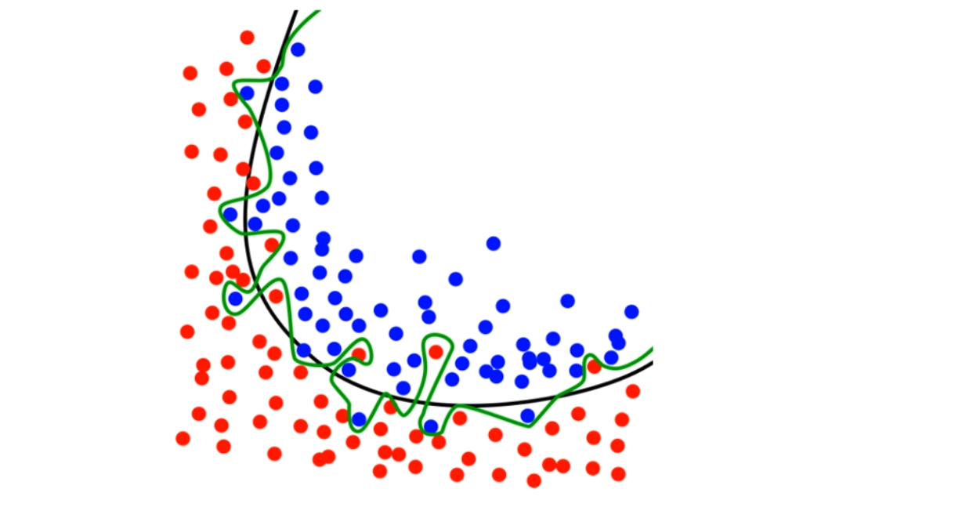

Slide 18
Accuracy
Accuracy = correctly classified observations/ all observations
48 / 50 = 96%

Slide 19
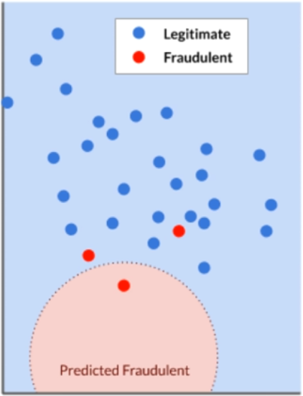
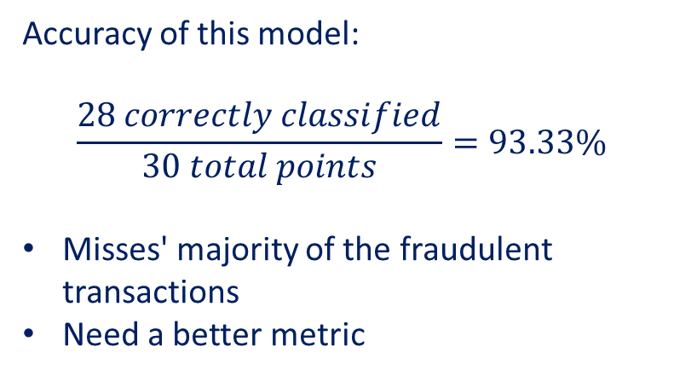
Limits of accuracy: fraud example
Accuracy of this model:
$$\frac{28 correctly classified}{30 total points}=93.33\%$$
Misses' majority of the fraudulent transactions
Need a better metric

Slide 20
Confusion matrix
Predicted Values
Fraudulent (Yes, 0,+) | Not Fraudulent (No, 1,-)
Actual Values
Fraudulent (Yes,0,+)
Not Fraudulent(N0,1, -)
1
True positive
0
False Positives

Slide 21

False Positives (Type I error)

Slide 22
Predicted Values
Fraudulent (Yes,0,+) | Not Fraudulent (No,1,-)
Actual Values
2
False Negatives
Fraudulent(Yes,0,+)
Not Fraudulent(No,1,-)
1
True positive
0
False Positive

Slide 23
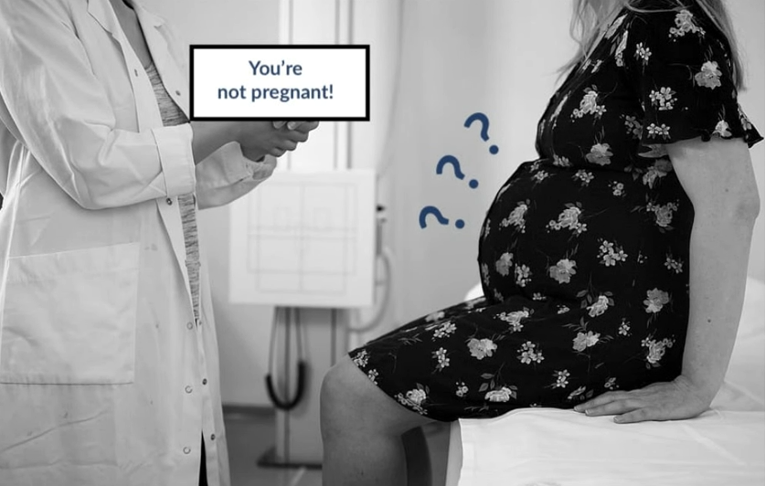
False Negative (Type II error)

Slide 24
Predicted Values
Fraudulent (Yes,0,+) | Not Fraudulent (No,1,-)
Actual Values
2
False Negatives
Fraudulent(Yes,0,+)
Not Fraudulent(No,1,-)
1
True positive
0
False Positive
27
True negatives

Slide 25
Why fill out this matrix
Predicted Values
Fraudulent (Yes,0) | Not Fraudulent (No,1)
Actual Values
2
False Negatives
Fraudulent(Yes,0)
Not Fraudulent(No,1)
1
True positive
0
False Positive
27
True negatives
How many fraudulent transactions did we classify correctly?

Slide 26
Improving Performance
3. Train model
4. Evaluate
Is the performance good enough?
No
Yes

Slide 27
Several Options
Dimensionality reduction
Hyper-parameter tuning
Ensemble methods

Slide 28

Dimensionality reduction
Reducing the number of features

Slide 29
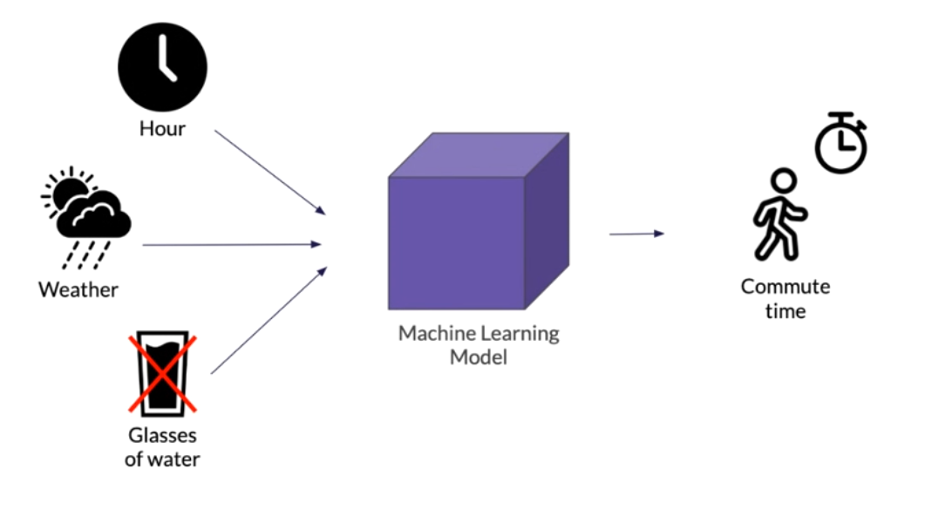
Dimensionality reduction: example
Irrelevance: some features don’t carry useful information.

Slide 30
Correlation: some features carry similar information
Keep only one feature
Height and Shoe size → height
Collapse multiple features into one underlying feature
Height and weight → Body Mass Index

Slide 31


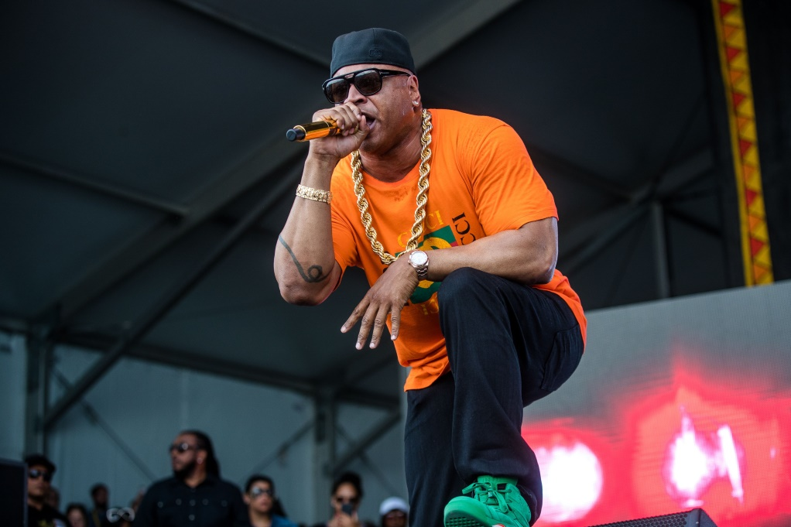

Hyperparameter tuning

Slide 32
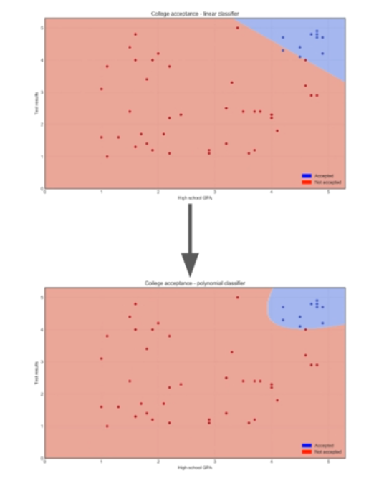
SVM algorithm hyperparameters:
Kernel: “linear” → ‘’poly”
Degree
Gamma
Shrinking
tol

Slide 33
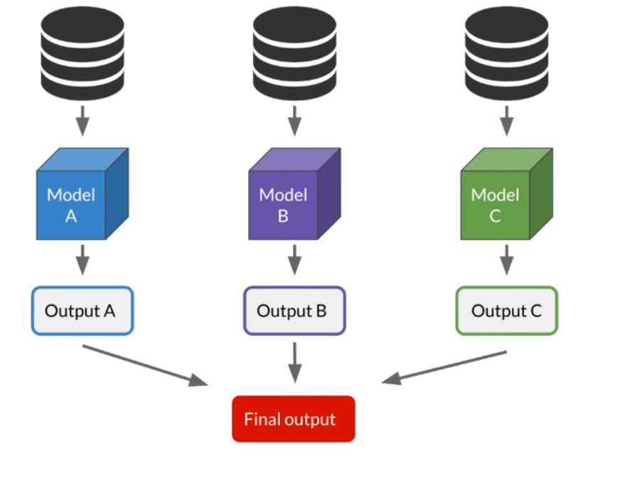
Ensemble methods

Slide 34
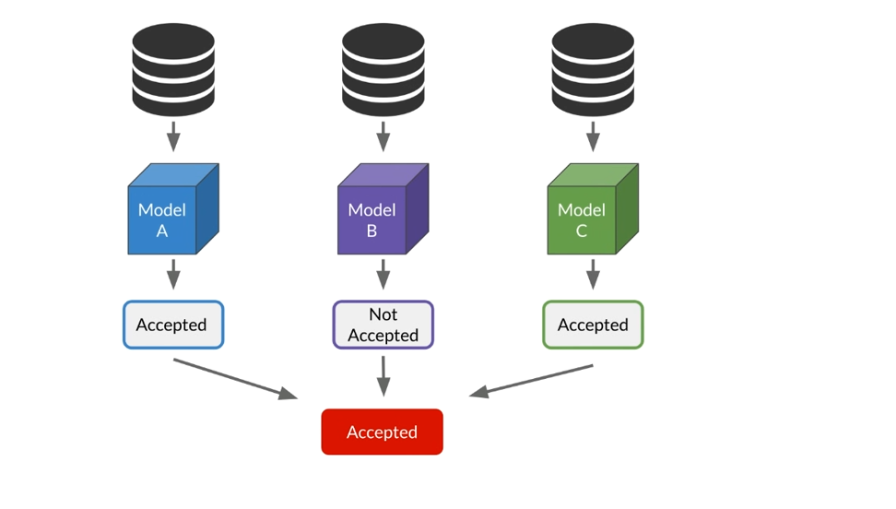
Classification: Voting

Slide 35
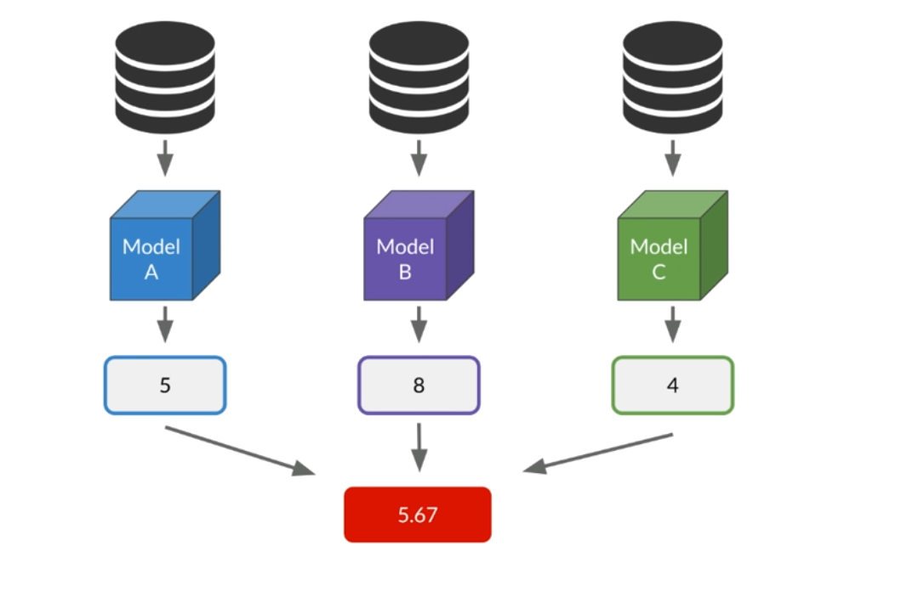
Regression: Averaging

Slide 36


Slide 37
YAKUB TRADING GROUP - ALGORITHMIC STAFF PROMOTION
Abdullah’s Baba Yakub, 38, is the heir apparent to the highly revered Yakub business dynasty. The enterprise has spanned decades with vast investment interest in all the various sectors of the economy.
Abdullah has worked for 16 years in Europe and America after his first and second degrees at Harvard University where he studied Engineering and Business Management. He is a very experienced technocrat and a global business leader who rose through the rank to become a Senior Vice President at a leading US business conglomerate. His dad is now 70 and has invited him to take over the company with a mandate to take it to the next level of growth as a sustainable legacy. Abdullah is trusted by his father and his siblings to lead this mandate.
On resumption, he had an open house with the staff to share his vision and to listen to them on how to take the business to the next level.

Slide 38
Beyond the general operational issues and increasing need for regulatory compliance, one of the issues raised by the staff was a general concern on the process of staff promotion. Many of the staff allege that it is skewed and biased. Abdullah understood the concern and promised to address it in a most scientific way.
You have been called in by Abdullah to use your machine learning skills to study the pattern of promotion. With this insight, he can understand the important features among available features that can be used to predict promotion eligibility.

Slide 39
• EmployeeNo : System-generated unique staff ID
• Division: Operational department where each employee works
• Qualification: Highest qualification received by the staff
• Gender: Male or Female
• ChannelofRecruitment: How the staff was recruited – this is via internal process, use of an agent or special referral
• Trainings_Attended : Unique paid and unpaid trainings attended by each staff in the previous business cycle
Yearofbirth: Year that the employee was born
• LastPerformanceScore Previous year overall performance HR score and rated on a scale of 0-14

Slide 40
Yearofrecruitment : The year that each staff was recruited into the company
• Targets_met: A measure of employees who meet the annual set target. If met, the staff scores 1 but if not, it is a 0.
• Previous_Award : An indicator of previous award won. If yes, it is a 1 and if No it is a 0.
• Trainingscoreaverage: Feedback score on training attended based on evaluation
• StateOfOrigin: The state that the employee claims
• Foreign_schooled: An indicator of staff who had any of their post-secondary education outside the country. Responses are in Yes or No
• Marital_Status: Marriage status of employees and recorded as Yes or No
• PastDisciplinaryAction : An indicator if a staff has been summoned to a disciplinary panel in the past. This is indicated as Yes or No
• PreviousIntraDepartmentalMovement : This is an indicator to identify staff who have moved between departments in the past. Yes and No are the responses.
• No_of_previous_employers : A list of the number of companies that an employee worked with before joining the organization.

Slide 41
Practice LAB

